Slide 1



GOOGLE LOOKER STUDIO
Collaborative Dashboards. Smarter Insights

Slide 2
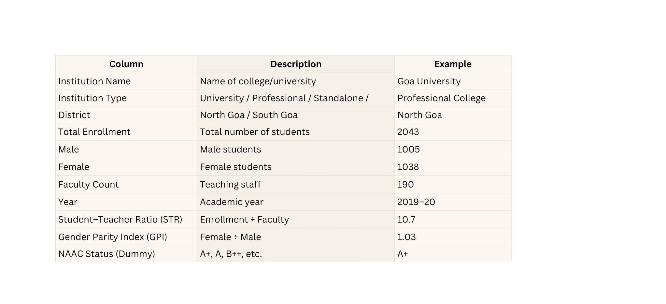


DATASET DESCRIPTION

Slide 3

Check and Clean Data Types
Check and Clean Data Types
  Goal: Make sure numbers and text are detected correctly.
  1️⃣ In the right panel, hover on each field name:
  - Total Enrollment, Male, Female, Faculty Count → should show 123 (Number)
  - Institution Name, Institution Type, District, Year → should show ABC (Text)
  If any numeric field shows ABC:
  Click the ABC icon → Number → Whole Number.

Slide 4


Create Calculated Fields
Create Calculated Fields
1️⃣ At the bottom of the field list → click ➕ Add a field.
2️⃣ Choose Add calculated field.
3️⃣ Name it: Student-Teacher Ratio
4️⃣ Paste this formula:
CASE
WHEN Faculty_Count = 0 OR Faculty_Count IS NULL THEN NULL
ELSE ROUND(Total_Enrollment / Faculty_Count, 2)
END
5️⃣ Click Save ✅
Goal: Make a new columns – Student-Teacher Ratio .

Slide 5
Create Calculated Fields
Create Calculated Fields
1️⃣ At the bottom of the field list → click ➕ Add a field.
2️⃣ Choose Add calculated field.
3️⃣ Name it: Gender Parity Index (GPI)
4️⃣ Paste this formula:
CASE
WHEN Male = 0 OR Male IS NULL THEN NULL
ELSE ROUND(Female / Male, 3)
END
5️⃣ Click Save ✅
Goal: Make a new columns – Gender Parity Index .

Slide 6

Data Analytics ..............................................................
BUILD VISUALS

Slide 7
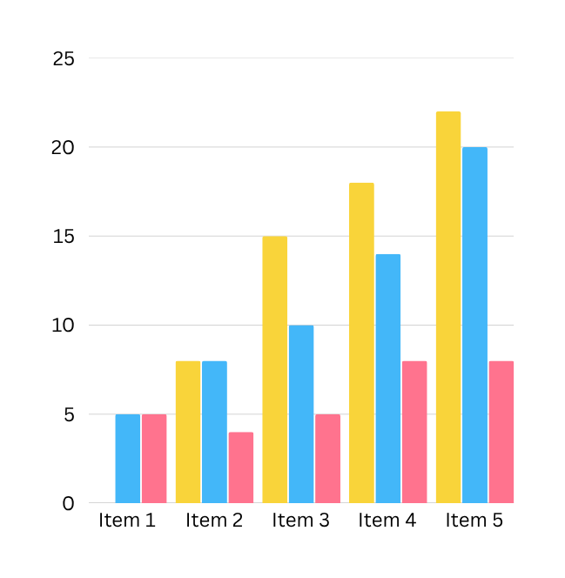
1.CLUSTERED BAR CHART ..............................................................
Gender-wise Enrollment by District
Goal: Compare male vs female student counts in North vs South Goa.
Steps:
  Click Add a chart → Bar → Stacked vertical bar chart.
  Click anywhere on the white canvas to place it.
  In the right panel (Setup tab):
Dimension → District
Metric 1→ Male
Metric 2→ Female
  Rename chart title →
Title: Gender-wise Enrollment by District – Goa HEIs
Style
1️⃣ Click Style tab.
2️⃣ Scroll to Series → Change color:
- Male = Blue #2E86C1
- Female = Gold #F4D03F
3️⃣ Turn Data Labels → ON
4️⃣ Legend → Top

Slide 8
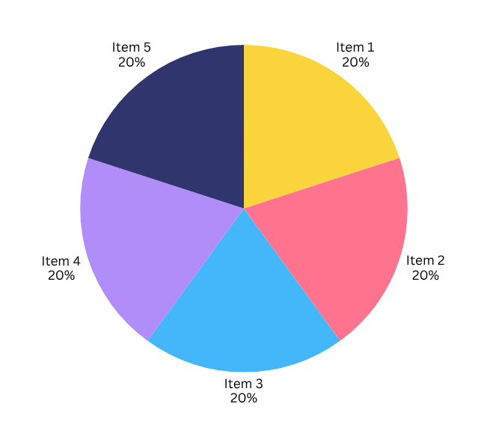
2.PIECHART ..............................................................
Enrollment by Institution Type
Goal: Show proportion of total enrollment by institution type.
Steps:
  Click Add a chart → Pie Chart → 1st option.
  In the right panel (Setup tab):
Dimension → Institution Type
Metric → Total Enrollment
  Rename chart title →
Title: Enrollment Distribution by Institution Type (2019–20)
Style
  Turn Slice labels → ON → Value and Percent.
  Legend → Right
  Optional colors:
Academic = Blue, Professional = Orange, Standalone = Green, University = Purple.

Slide 9
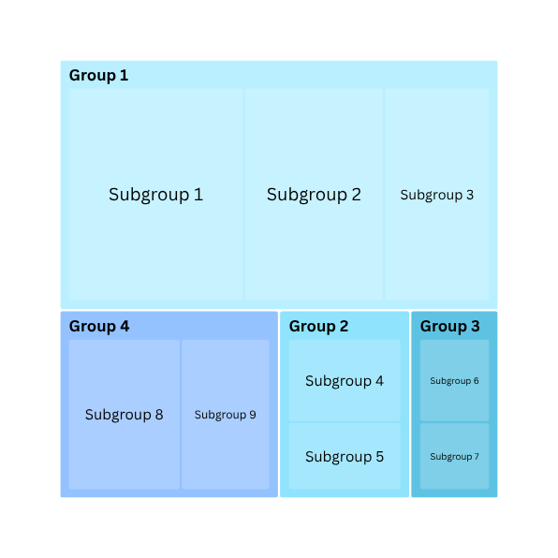
2.TABLE ..............................................................
Institution-wise Student-Teacher Ratio Table
Goal: Compare Faculty Count, Total Enrollment and STR per institution.
Steps:
  Click Add a chart → Table → Plain Table.
  In the right panel (Setup tab):
Dimension → Institution Name
Optional Dimension → District
Metric → Faculty Count, Total Enrollment, Student-Teacher Ratio
  Rename chart title →
Title: Institution-wise Student-Teacher Ratio
Style
1️⃣ Go to Style tab.
2️⃣ Scroll to Table colours.
- Header background: #E9EEF7
- Odd row colour: #FFFFFF
- Even row colour: #F7F9FB
3️⃣ Show row numbers → ON
4️⃣ Font: Arial / Segoe UI
5️⃣ Title: Institution-wise Student–Teacher Ratio (STR)

Slide 10







Add Interactive Filters (Slicers)
01
02
03
  Add District Filter
  Add Institution Type Filter
  Style
  Click Add a control → Drop-down list
  Show search box → ON
  Click Add a control → Drop-down list
  Click above your charts to place it.
  Background: White #FFFFFF
  Place beside the first filter
  Setup tab → Control field → District.
  Control field → Institution Type.
  Border: Light Gray #D9D9D9
  Rename title: Filter by District.
  Rename title: Filter by Institution Type.

Slide 11
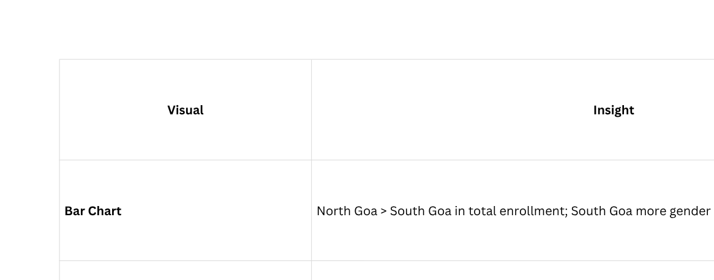
INSIGHTS

